Slide 1
Unit -2(Intelligent Agent)
Dipesh Koirala

Slide 2

Topics Covered
Introduction of agents, Structure ,Properties of Intelligent Agents
Configuration of Agents, PEAS description of Agents
Types of Agents: Simple Reflexive, Model based, Goal based, Utility based
Environment Types: Deterministic, Stochastic, Static, Dynamic, Observable, Semi-observable, Single agent, multi agent

Slide 3

Intelligent Agent
An intelligent agent is an autonomous entity that acts.
Directed its activity towards achieving goals upon an environment.
It perceives its environment via sensors and acts rationally upon that environment with its effectors (actuators)
Hence, an agent gets percepts one at a time, and maps this percept sequence to actions.

Slide 4
Intelligent Agent
An intelligent agent is a program that can meet its target or goal based on its environment, user input and past percept sequence.
Agent Terminology
Sensors: tools to percept its inputs
Actuators: tools to perform action
Percept : perceptual inputs at given instance
Percept Sequence: history of all that an agent has perceived till date
Action of agent: something that agent performs after given any sequence of inputs
Performance measure: criteria which determines how successful an agent is
Agent function: map from input sequence to an action.

Slide 5
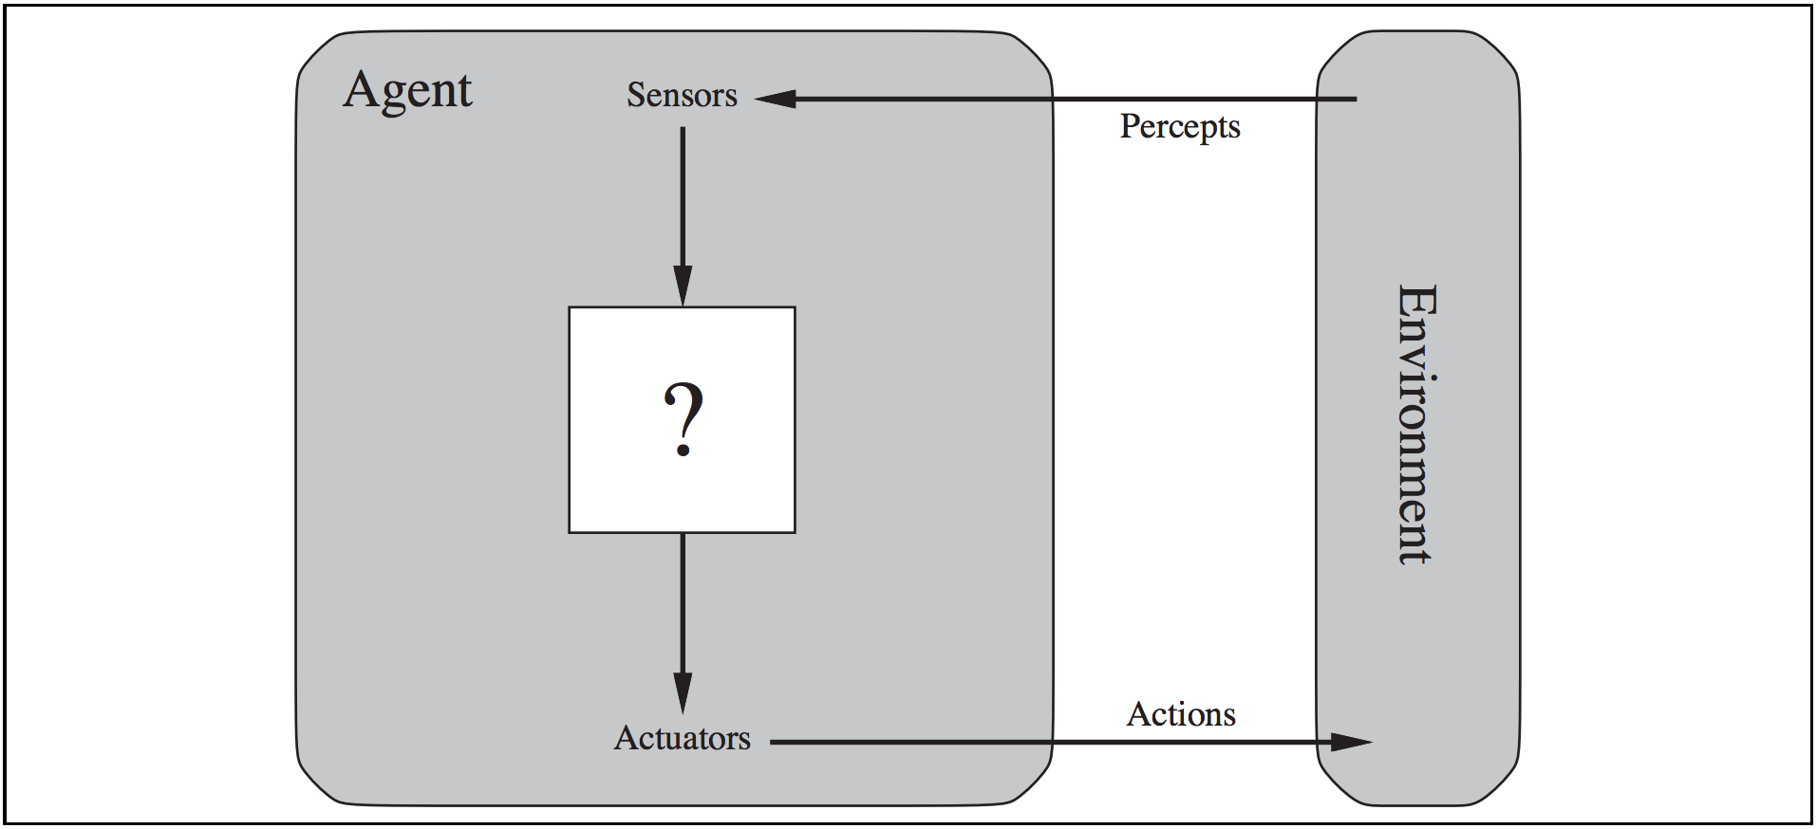
Structure of Agent
Agent = Architecture + Agent Program
Agent function is mathematical concept that maps percept sequence to an action.
ƒ: P* -> A
The agent function will internally represented by the agent program.
The agent program is concrete implementation of agent function it runs on the physical architecture to produce A.

Slide 6
Example
Sensors/percepts and effectors/actions
For Humans:
Sensors: Eyes (vision), ears (hearing), skin (touch), tongue (gestation), nose (olfaction)
Percepts:
At the lowest level – electrical signals from these sensors
After preprocessing – objects in the visual field (location, textures, colors, …), auditory streams (pitch, loudness, direction), …
Effectors: limbs, digits, eyes, tongue, …..
Actions: lift a finger, turn left, walk, run, carry an object, …

Slide 7
Example
A more specific example: Automated taxi driving system
Percepts: Video, sonar, speedometer, odometer, engine sensors, keyboard input, microphone, GPS, …
Actions: Steer, accelerate, brake, horn, speak/display, …
Goals: Maintain safety, reach destination, maximize profits (fuel, tire wear), obey laws, provide passenger comfort, …
Environment: Urban streets, freeways, traffic, pedestrians, weather, customers, …

Slide 8
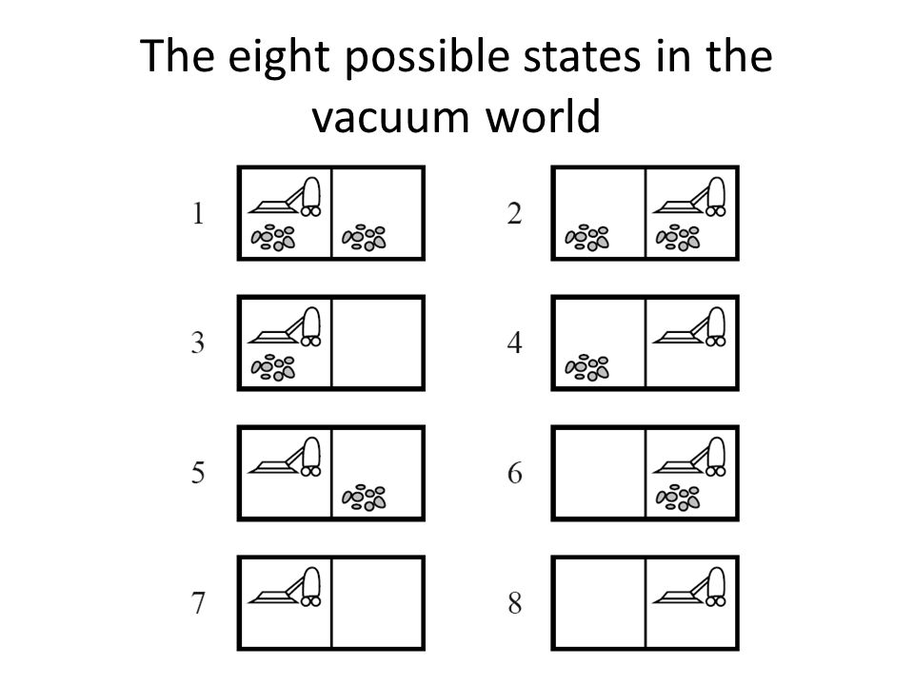
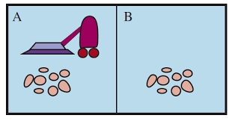
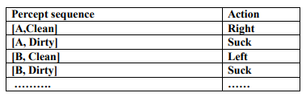
Example
The vacuum – cleaner world: Example of agent
Environment: square A and B
Percepts: [location and content] E.g. [A, Dirty]
Actions: left, right, suck, and no-op

Slide 9
The concept of rationality
A rational agent is one that does the right thing
Right thing – actions that will cause the agent to be most successful.
Therefore we need to measure success of an agent.
Performance measures are the criterion for success of an agent behavior.
E.g. In vacuum cleaner
Agent is rational if every entry in the table is filled out correctly.
Performance measure of a vacuum-cleaner agent could be amount of dirt cleaned up, amount of time taken, amount of electricity consumed, amount of noise generated etc.

Slide 10
The concept of rationality
It is better to design Performance measure according to what is wanted in the environment instead of how the agents should behave.
It is not easy task to choose the performance measure of an agent.
For example if the performance measure for automated vacuum cleaner is “The amount of dirt cleaned within a certain time”.
Then a rational agent can maximize this performance by cleaning up the dirt , then dumping it all on the floor, then cleaning it up again , and so on.
Therefore “How clean the floor is” is better choice for performance measure of vacuum cleaner

Slide 11
The concept of rationality
What is rational at a given time depends on four things:
Performance measure
Prior environment knowledge
Actions
Percept sequence to date
A rational agent chooses whichever action maximizes the expected value of the performance measure given the percept sequence to date and prior environment knowledge.

Slide 12
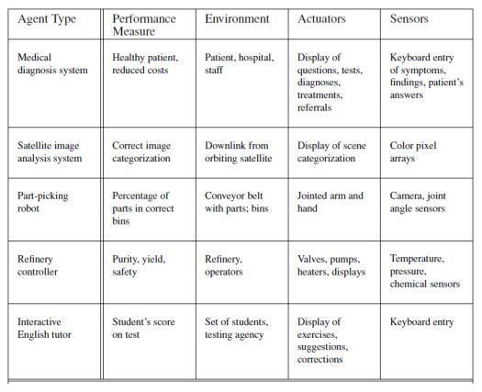
Configuration of Agents: PEAS Description
Task Environment

Slide 13
Configuration of Agents: PEAS Description
Task Environment

Slide 14
Environment Types
Fully observable vs Partially observable
Single agent vs Multi-agent
Deterministic vs Stochastic
Episodic vs Sequential
Static vs Dynamic
Discrete vs Continuous

Slide 15
Environment Types
Fully observable and Partially observable:
If an agent’s sensors give it access to the complete state of the environment at each point in time, then we say that the task environment is fully observable.
A task environment is effectively fully observable if the sensors detect all aspects that are relevant to the choice of action.
Fully observable environments are convenient because the agent need not maintain any internal state to keep track of the world.
For example: chess playing

Slide 16
Environment Types
Fully observable and Partially observable:
An environment might be partially observable because of noisy and inaccurate sensors or because parts of the state are simply missing from the sensor data.
For eg: a vacuum agent with only a local dirt sensor cannot tell whether there is dirt in other squares
an automated taxi cannot see what other drivers are thinking.

Slide 17
Environment Types
Single agent vs Multi-agent
The distinction between single-agent and multi-agent is determined by number of agents involved.
For eg: an agent solving a crossword puzzle by itself is clearly in a single-agent environment, whereas an agent playing chess is in a two-agent environment.
In multi-agent more than one agent are involved in solving problem.

Slide 18
Environment Types
Deterministic vs. Stochastic
If the next state of the environment is completely determined by the current state and the action executed by the agent, then we say the environment is deterministic; otherwise, it is stochastic.
For e.g: The simple vacuum world is deterministic where as the Taxi driving is clearly stochastic in this sense, because one can never predict the behavior of traffic exactly; moreover, one's tires blow out and one's engine seizes up without warning.

Slide 19
Environment Types
Episodic vs Sequential
In an episodic task environment, the agent’s experience is divided into atomic episodes.
In each episode the agent receives a percept and then performs a single action.
Crucially, the next episode does not depend on the actions taken in previous episodes.
For e.g: an agent that has to spot defective parts on an assembly line bases each decision on the current part, regardless of previous decisions
moreover, the current decision doesn't affect whether the next part is defective.
In sequential environments, on the other hand, the current decision could affect all future decisions.
For e.g: Chess and taxi driving are sequential

Slide 20
Environment Types
Static vs Dynamic:
If the environment can change while an agent is deliberating, then the environment is dynamic for that agent; otherwise, it is static.
Static environments are easy to deal with because the agent need not keep looking at the world while it is deciding on an action, nor need it worry about the passage of time.
For e.g.: Crossword puzzles are static.
Dynamic environments, on the other hand, are continuously asking the agent what it wants to do; if it hasn't decided yet, that counts as deciding to do nothing.
For e.g.: Taxi driving is dynamic because the other cars and the taxi itself keep moving while the driving algorithm dithers about what to do next.

Slide 21
Environment Types
Discrete vs Continuous:
The discrete/continuous distinction can be applied to the state of the environment, to the way time is handled, and to the percepts and actions of the agent.
For e.g., a discrete-state environment such as a chess game has a finite number of distinct states. Chess also has a discrete set of percepts and actions.
E.g. of continuous state environment includes Taxi driving : the speed and location of the taxi sweep through a range of continuous values and do so smoothly over time.

Slide 22
Agent Types
Agents are grouped into five classes based on their degree of perceived intelligence and capability:
simple reflex agents
Model-based reflex agents
Goal-based agents
Utility-based agents
Learning agents

Slide 23
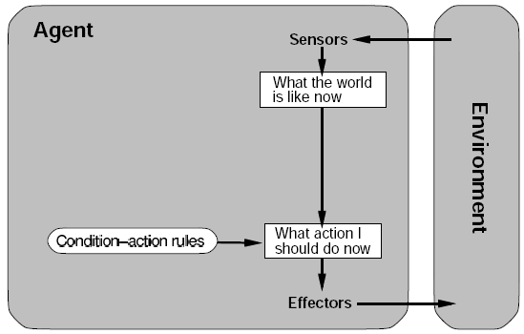
Agent Types
Simple reflex agents
The simplest kind of agent is the simple reflex agent.
These agents select actions on the basis of the current percept, ignoring the rest of the percept history.
Maintains condition-action rules.
Will work only if the correct decision can be made on the basis of only the current percept.
For eg: vacuum cleaner agent

Slide 24
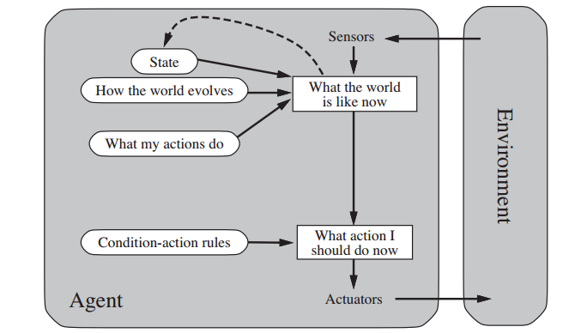
Agent Types
Model Based Agent:
Maintain a internal state to keep track of part of world it can not see now.
Handles partial observability
Internal state is based on percept history and keeps two kinds of knowledge:
How the world evolves independently of the agent
How the agent's own actions affect the world
Then it combines current percept with the old internal state to generate the updated description of the current state.
It then chooses an action in the same way as reflex agent.

Slide 25
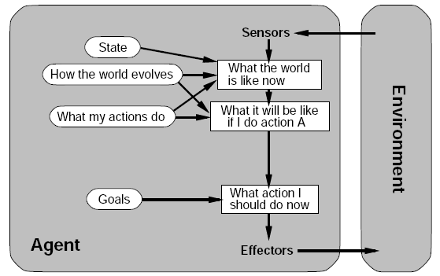
Agent Types
Goal Based Agent:
Goal-based agents further expand on the capabilities of the model based agents, by using "goal" information.
Knowing something about the current state of the environment is not always enough to decide what to do. For example, at a road junction, the taxi can turn left, turn right, or go straight on.
The correct decision depends on where the taxi is trying to get to.
In other words, as well as a current state description, the agent needs some sort of goal information that describes situations that are desirable
For e.g. being at the passenger’s destination

Slide 26
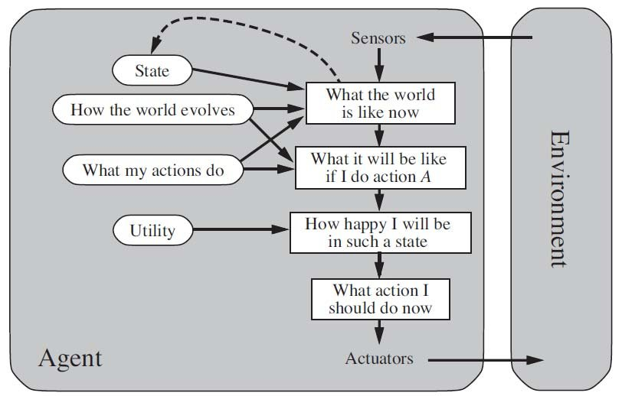
Agent Types
Utility Based Agent:
Goal-based agents only distinguish between goal states and non-goal states.
Goals alone are not enough to generate high-quality behavior in most environments. For e.g, many action sequences will get the taxi to its destination (thereby achieving the goal) but some are quicker, safer, more reliable, or cheaper than others.
Goals just provide a crude binary distinction between “happy” and “unhappy” states.
A more general performance measure should allow a comparison of different world states according to exactly how happy they would make the agent.
Because “happy” does not sound very scientific, economists and computer scientists use the term utility instead.

Slide 27
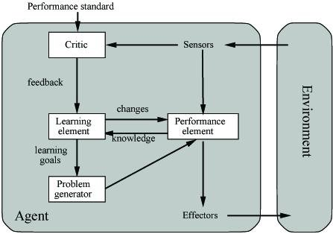
Agent Types
Learning Agent:
A learning agent can be divided into four conceptual components:
"learning element", which is responsible for making improvements
"performance element” (entire agent), which is responsible for selecting external actions. i.e., it takes in percepts and decides on actions.
The learning element uses feedback from the "critic" on how the agent is doing and determines how the performance element should be modified to do better in the future.
The last component of the learning agent is the "problem generator". It is responsible for suggesting actions that will lead to new and informative experiences.

Slide 28
Thank you!

